Slide 1


SMART INDIA HACKATHON 2025
TITLE PAGE
Problem Statement ID – SIH25012
Problem Statement Title-
Automated Attendance System for Rural Schools
Theme-Smart Education
PS Category- Software
Team Name - Code2Career

Slide 2
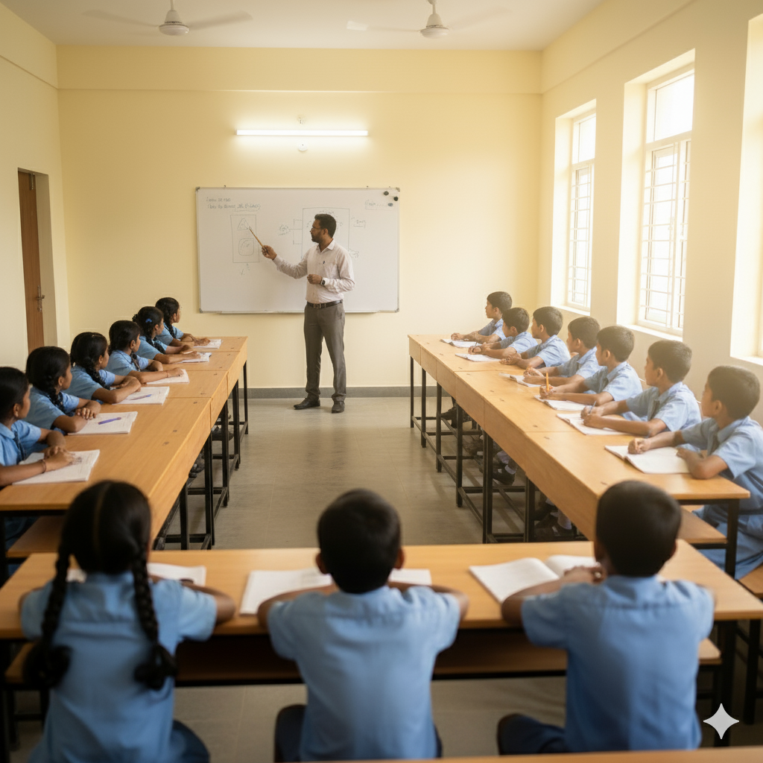
IDEA TITLE
Code2Career
“A low-cost digital attendance framework designed to save time, reduce errors, and enhance efficiency in rural education systems.”
Solution :
Explanation:
Efficient Attendance: A single photo captures all students, and the system instantly marks attendance using face recognition.
Accurate & Reliable: Automatic face matching prevents proxy attendance and ensures every student is correctly recorded.
Innovation and Uniqueness :
Seamless Integration of Tech and Seating Design: Combines a U-shaped or curved seating layout with face recognition technology, ensuring every student is visible and attendance can be captured instantly.
Enhanced Classroom Interaction: The modern seating arrangement promotes better teacher-student engagement, turning attendance into a process that supports learning, not just record-keeping.

Slide 3
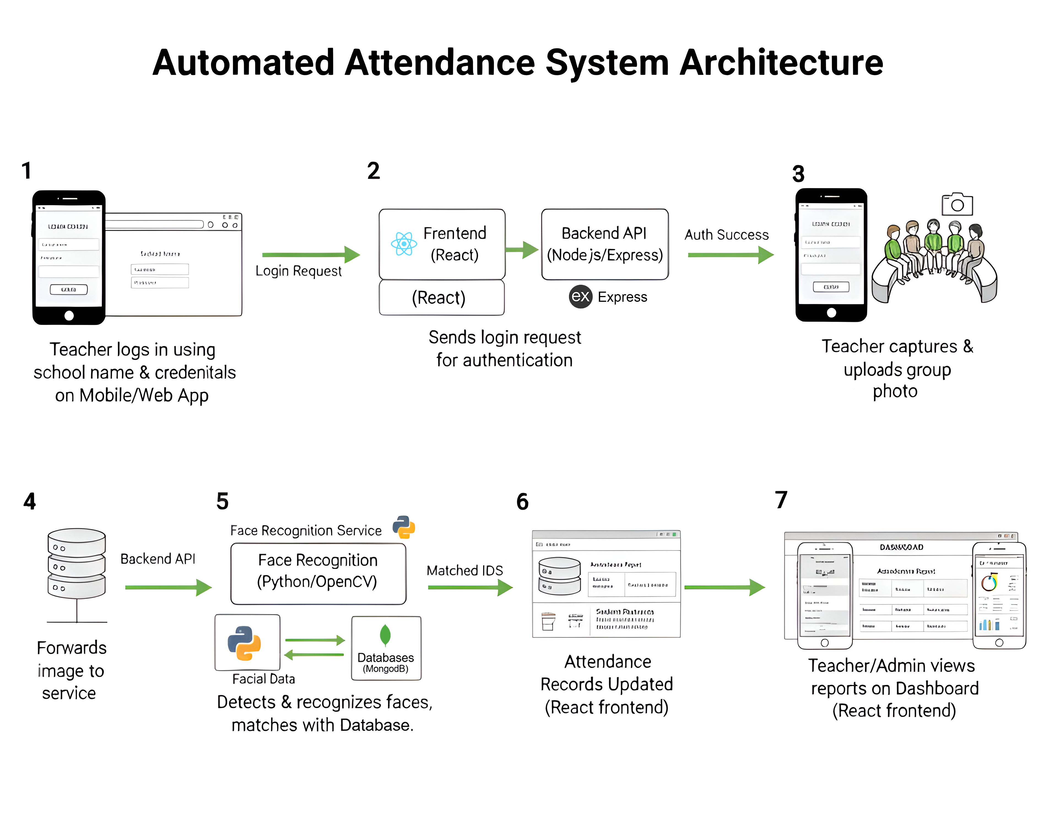
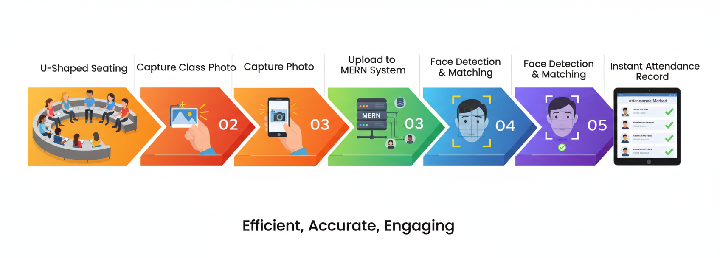

TECHNICAL APPROACH
Code2Career
Core Workflow :
A teacher logs in using a mobile or web app and uploads a group photo of the students. The image is processed by a Face Recognition Service (built with Python/OpenCV) that detects faces and matches them against a facial data database. The system then automatically updates attendance records for all recognized students. Finally, teachers and administrators can view real-time attendance reports on a dedicated dashboard.
Technology Stack and Version Control & Collaboration :

Slide 4
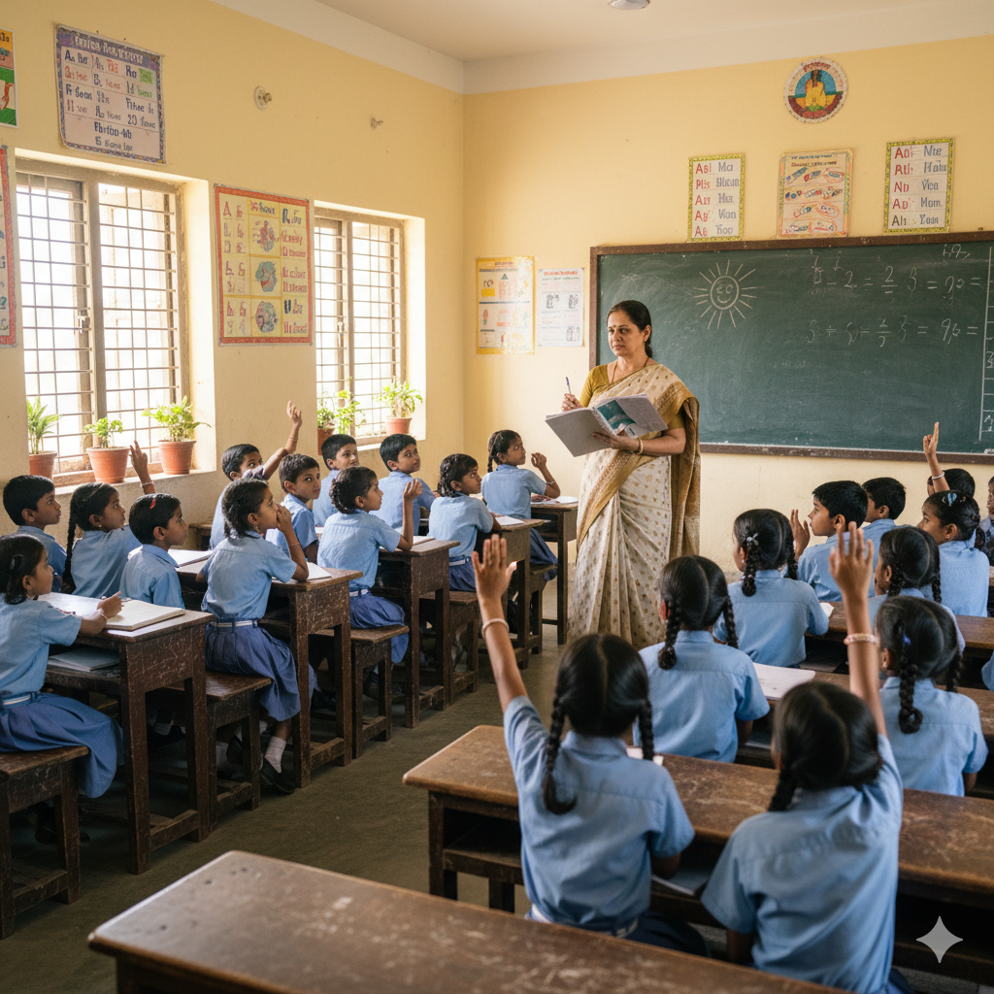
FEASIBILITY AND VIABILITY
Code2Career
Feasibility of the Idea:
Uses a phone or a webcam with MERN-based face recognition, low-cost and easy to deploy.
Potentials & Challenges:
Saves teachers’ time, improves accuracy, prevents proxy attendance, and engages students, while facing limited connectivity, budget constraints, teacher adaptation, and data privacy concerns.
Strategies to overcome the above challenges are:
Use offline-first apps to handle poor internet.
Deploy low-cost devices in rural schools.
Enable quick attendance verification reports for teachers and
administrators.
Use simple icons and color codes to make the interface intuitive.
Implement strong data protection measures.

Slide 5
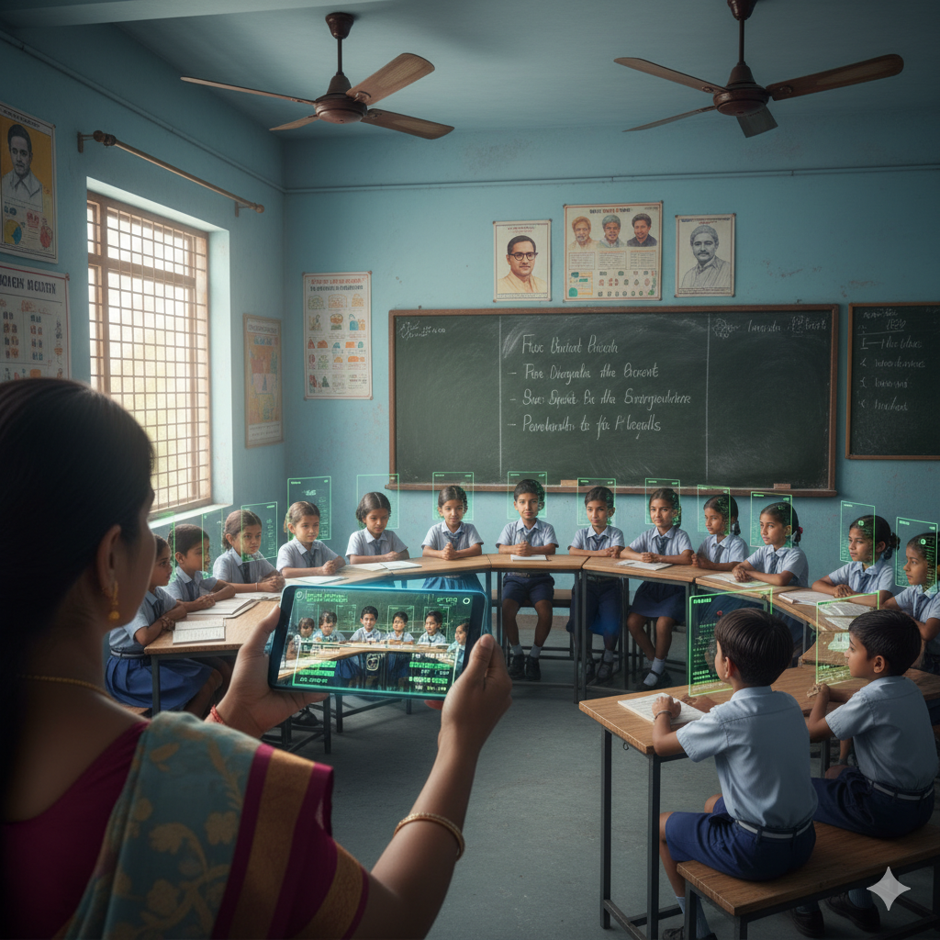
IMPACT AND BENEFITS
Code2Career
Potential impact on the target audience
Eliminate attendance-related disputes and errors
Better classroom engagement through U-shaped seating
Real-time data analytics for attendance patterns and trends.
Direct alignment with National Education Policy 2020 digitization goals.
Social Benefits
Brings modern technology to underserved rural areas
Complete proxy attendance elimination ensures honest participation and resource allocation
Economical Benefits
Real-time insights for education ministers to track rural education progress instantly
Accurate headcounts prevent wastage in mid-day meal
Environmental Benefits
Minimal paper usage and printing requirements
Long-term digital solution with minimal maintenance

Slide 6
RESEARCH AND REFERENCES
Code2Career
Aditi Dankar and Poornima Panduranga Kundapur, “Automated Mobile Attendance System (AMAS),” 2019 International Conference on Advances in Computing, Communication and Control (ICAC3), IEEE, 2019.
Ashesh Kumar, Sumitra Samal, Manpreet Singh Saluja, and Aaryan Tiwari, “Automated Attendance System Based on Face Recognition Using OpenCV,” 2023 9th International Conference on Advanced Computing and Communication Systems (ICACCS), IEEE, 2023.
Paniti Netinant, Nongnapus Akkharasup-Anan, and Meennapa Rakhiran, “Class Attendance System using Unimodal Face Recognition System based on Internet of Educational Things” 2023 IEEE 6th Eurasian Conference on Educational Innovation (ECEI), IEEE, 2023.
Hemavathi S., Sathishkumar M., Chandru I., Perumal N., K. Jayasakthi Velmurugan, and A. Shali, “Automated Attendance System,” 2024 International Conference on Power, Energy, Control and Transmission Systems (ICPECTS), IEEE, 2024.
Shaikha Alfalasi, Sara Almarzooqi, Hamda Ali, and Dina Tbaishat, “Development of Attendance Tracking System for Enhanced Efficiency: Sukaina Bint Al Hussein High School Case Study,” 2024 International Conference on Computer and Applications (ICCA), IEEE, 2024.
Shalini S., Varshni Kanna M., and Kirubakaran D., “Development of Smart School ID Card System for Maintaining Attendance Record,” 2024 3rd International Conference on Automation, Computing and Renewable Systems (ICACRS), IEEE, 2024.

